Slide 1
Chinook SQL Analysis
Unlocking Insights with SQL
Suyesh Pandit

Slide 2
Problem statement
I’ve been hired as a data analyst at Chinook, and my goal is to analyze music record sales data to uncover insights and provide recommendations that can help shape the company’s strategy in the physical music market.
My task is to dive into the data and extract meaningful insights for better decision-making.

Slide 3
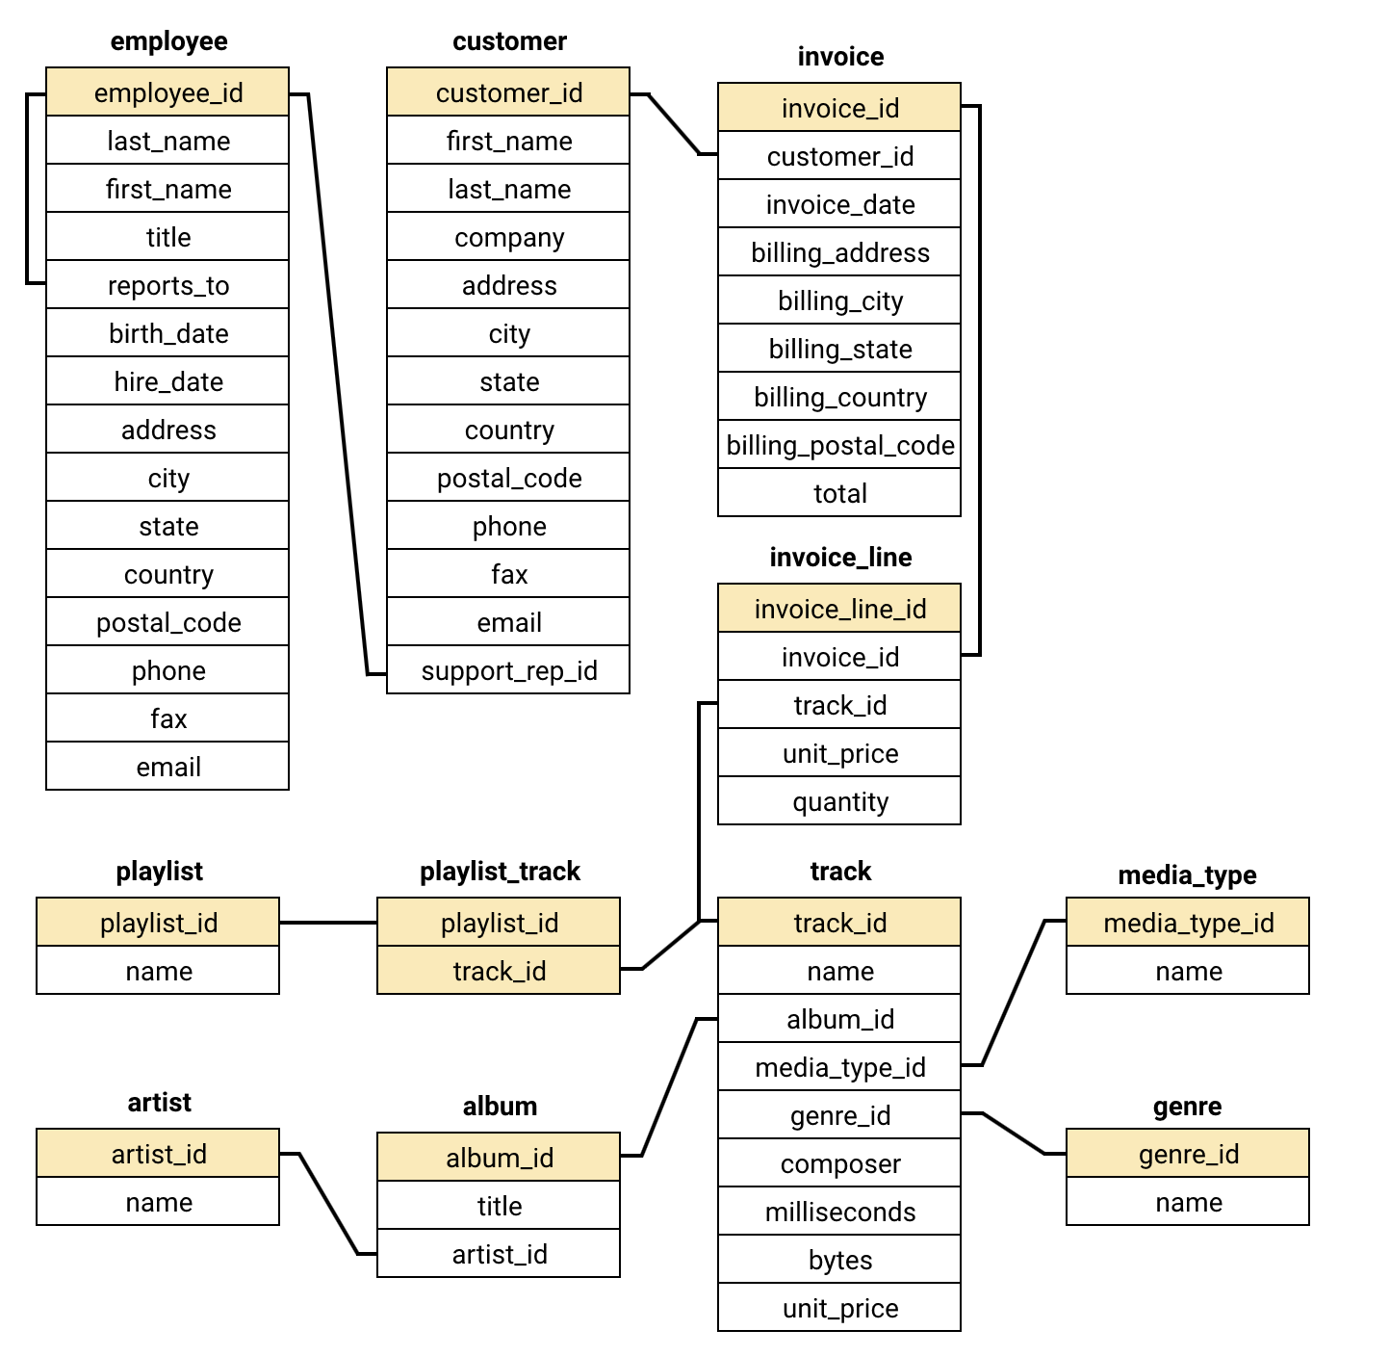
Database schema

Slide 4
Data description
customer:
customer_id: Unique identifier assigned to each customer.
first_name: The given name or first name of a customer.
last_name: The surname or family name of a customer.
company: The name of the company associated with a customer.
address: The street address of a customer's location.
city: The city where a customer is located.
state: The state or province where a customer is located.
country: The country where a customer is located.
postal_code: The postal or zip code of a customer's address.
phone: The phone number of a customer.
fax: The fax number associated with a customer.
email: The email address of a customer.
support_rep_id: The employee ID of the support representative assigned to a customer.
invoice:
invoice_id: Unique identifier assigned to each invoice.
customer_id: The customer ID associated with the invoice.
invoice_date: The date when the invoice was generated or issued.
billing_address: The street address used for billing purposes.
billing_city: The city used for billing purposes.
billing_state: The state or province used for billing purposes.
billing_country: The country used for billing purposes.
billing_postal_code: The postal or zip code used for billing purposes.
total: The total amount due on the invoice.

Slide 5
Data description
invoice:
invoice_id: Unique identifier assigned to each invoice.
customer_id: The customer ID associated with the invoice.
invoice_date: The date when the invoice was generated or issued.
billing_address: The street address used for billing purposes.
billing_city: The city used for billing purposes.
billing_state: The state or province used for billing purposes.
billing_country: The country used for billing purposes.
billing_postal_code: The postal or zip code used for billing purposes.
total: The total amount due on the invoice.
invoice_line:
invoice_line_id: Unique identifier assigned to each line item on an invoice.
invoice_id: The invoice ID to which the line item belongs.
track_id: The ID of the track or product included in the line item.
unit_price: The price per unit for the line item.
quantity: The quantity of units for the line item.
playlist:
playlist_id: Unique identifier assigned to each playlist.
name: The name or title of the playlist.
playlist_track:
playlist_id: The ID of the playlist to which the track belongs.
track_id: The ID of the track included in the playlist.
track:
track_id: Unique identifier assigned to each track or song.
name: The title or name of the track.
album_id: The ID of the album to which the track belongs.
media_type_id: The ID of the media type associated with the track.
genre_id: The ID of the genre associated with the track.
composer: The name of the composer or artist who composed the track.
milliseconds: The duration of the track in milliseconds.
bytes: The file size of the track in bytes.
unit_price: The price per unit for the track.

Slide 6
Data description
album:
album_id: Unique identifier assigned to each album.
title: The title or name of the album.
artist_id: The ID of the artist associated with the album.
artist:
artist_id: Unique identifier assigned to each artist.
name: The name of the artist.
media_type:
media_type_id: Unique identifier assigned to each media type.
name: The name or description of the media type (e.g., MPEG audio file, AAC audio file).
genre:
genre_id: Unique identifier assigned to each genre.
name: The name or description of the genre (e.g., rock, pop, classical).

Slide 7
Methodology
Steps Taken:
Data Cleaning: Identified and rectified missing, duplicate, or inconsistent data to ensure a clean dataset for analysis.
Feature Engineering: Generated new, meaningful features from the existing data to improve model performance or gain deeper insights.
SQL Queries: Wrote and optimized SQL queries to extract, filter, and manipulate data efficiently for analysis.
Tools and Techniques:
SQL and Database Functions: Leveraged SQL functions such as joins, aggregations, and window functions to process data effectively.
Data Handling: Used database management tools to ensure data integrity and accessibility.
Visualization Tools:
Excel: Utilized for creating quick charts, pivot tables, and summarizing data insights.

Slide 8
Analysis

Slide 11
Strategic Recommendation
Top US Genres to Focus On:
Rock (561M sales) - clearly dominates the market
Metal & Alternative/Punk (124M-130M each)
R&B/Soul (53M)
Marketing Plan:
Put most marketing money into Rock music
Target Metal and Alternative fans together
Create special deals for these popular genres
Best Markets:
USA ($1,040M)
Canada ($535M)
Brazil ($427M)
Quick Actions:
Start a rewards program for regular customers
Make different ads for different countries
Focus on big cities like Mountain View, Prague, and London
Partner with local music scenes in these cities

Slide 12
Area of Improvement
Grow Smaller Markets:
Focus on India, Ireland, and Portugal
These have lower sales but good potential
Partner with local artists and events
Make mobile buying easier
Use Popular Music to Sell More:
Connect fans of similar artists (AC/DC, Black Sabbath)
If someone likes rock, show them more rock
Mix famous and new artists in playlists
Smart Pricing:
Different prices for different countries
Make special deals for students
Create family plans
Offer bundles of similar music

Slide 13
Conclusion
The analysis reveals clear patterns in market performance, customer preferences, and growth opportunities. With Rock music dominating sales (561M in USA), strong regional markets like the USA ($1,040M), and emerging opportunities in cities like Prague ($273M), we have solid data to guide strategic decisions.
By using these insights, we can:
Target marketing where it matters most
Grow in promising new markets
Price effectively for each region
Connect better with customers through their preferred music
Every recommendation is backed by clear numbers, ensuring resources are invested where they'll have the greatest impact. This data-driven approach provides a strong foundation for sustainable growth and customer satisfaction.

Slide 14
Thank you

